Slide 1
Getting started with SharePoint Framework
Introducing SharePoint Framework

Slide 2
Agenda
Overview
Demo
Extending
Q&A

Slide 3


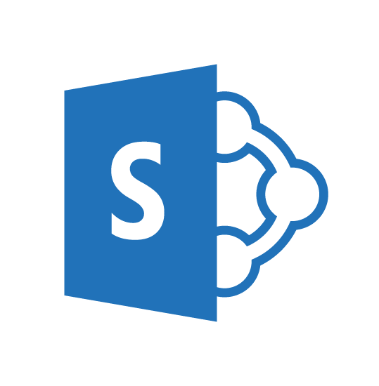
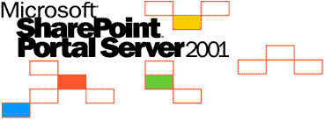
SharePoint UX – Evolving cross versions
SharePoint
Portal Server 2001
SharePoint
Portal Server 2003
Office SharePoint
Server 2007
SharePoint
Server 2010
SharePoint
Server 2013
SharePoint
Server 2016, SPO
2001
2003
2006
2009
2012
2016 …
ASP
Early Server Widget Tech
Single Box
ASP.NET
WebParts
CAML
SharePoint Publishing
FAST acquisition
Shared Services (e.g. taxonomy)
First Client Side Rendering Using XSL
Search driven publishing sites
Client Side Rendering sprinkled in, e.g. CBS, MDS, etc.
Hybrid
Modern standalone cloud apps, e.g. O365 Video, Delve, etc.
…
SPFx and Office Fabric
Modern SharePoint pages
Notes:
Tahoe/SPS 2001 – ASP Based, Single Box
Russ Started Here
SPS 2003 – Moved to ASP.NET, scale out, enterprise manageability
SPS 2007 – Added ECM, Publishing, Shared Services
John Started Here
SPS 2010 – FAST acquisition, search driven portals, scaled up doclibs
SPS 2013 – Multitenant, base for our cloud based release
SPS 2016 – First version migrated back from Cloud
Transitioning over to JohnFan

Slide 4
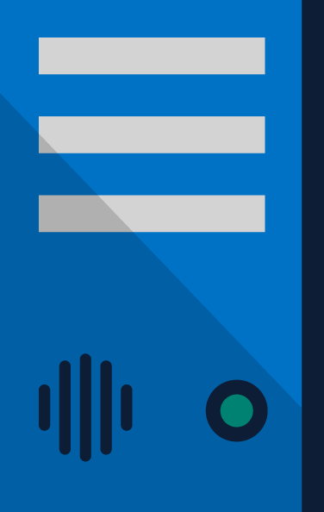
SharePoint Extensibility Principles Build long-term, value-added services for enterprise mobility
Principles
To provide an Application Development Framework that aligns 1st and 3rd parties
To build industry leading client side solutions On-Premises and in the Cloud
Unlocking the potentials of SharePoint and the Microsoft Graph on desktops or any device
Notes:
Over the past several years, with the evolution of Office 365, development of SharePoint solutions has encountered a new set of challenges: while on one hand IT and Tenant administrators require a new set of tools to control how data get accessed and consumed in their tenancies, developers, on the other hand, want to programmatically control the whole lifecycle, experience, and data access capabilities of a Site.
Unfortunately, developers today find themselves constraint around building app parts as a result of iFrames, a reduced set of APIs, and no integration with cross Office 365 workloads. This in turn limits their ability to develop powerful portals that extend SharePoint.
The client-side development framework will deliver capabilities that will help both first party and third party developers build powerful, rich applications and provide an enjoyable web experience in Office 365 for end users that are both intuitive and simple to consume.

Slide 5
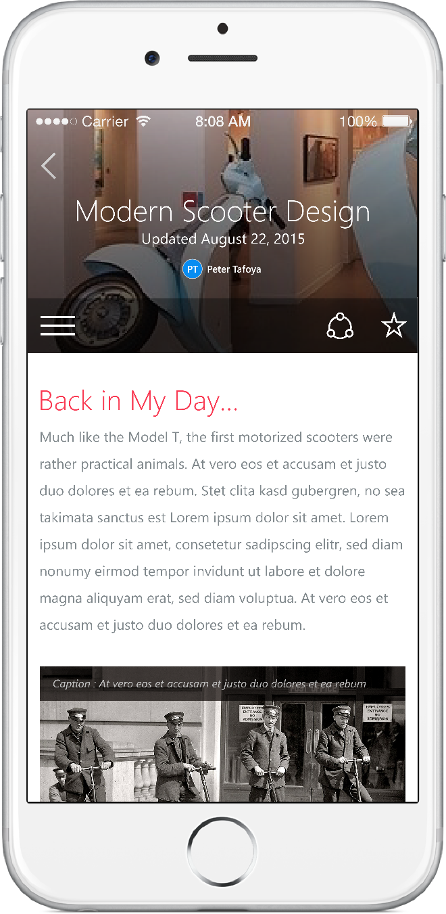
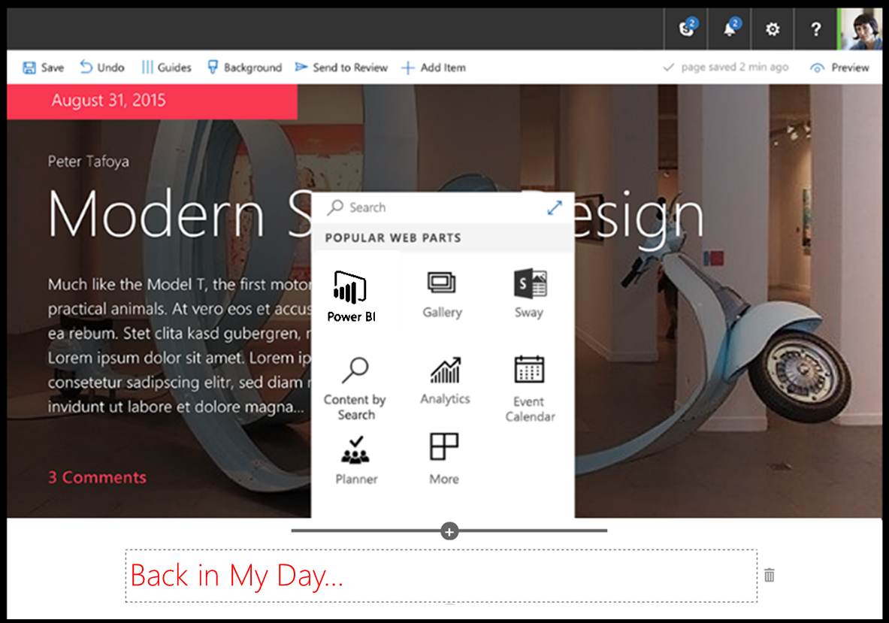
SharePoint Framework
Modern client-side development
Lightweight web and mobile
Powers our own experiences
Backward compatible
Supports open source tools and JavaScript web frameworks
SharePoint framework
Microsoft Graph
LOB Systems and Cloud Services
Notes:
Built into the SharePoint mobile apps

Slide 6
What’s a modern page?
Client-side rendered
CDN deployed
Client-side web parts
Client-side and persisted caches
Mobile optimized
Notes:
Client-side rendered using Open Source web tech, predominantly React and Office Fabric
CDN deployed “single-page” web apps with client side interactivity and fast page routing
Client-side web parts
Client-side and persisted caches
Mobile optimized (responsive)

Slide 7
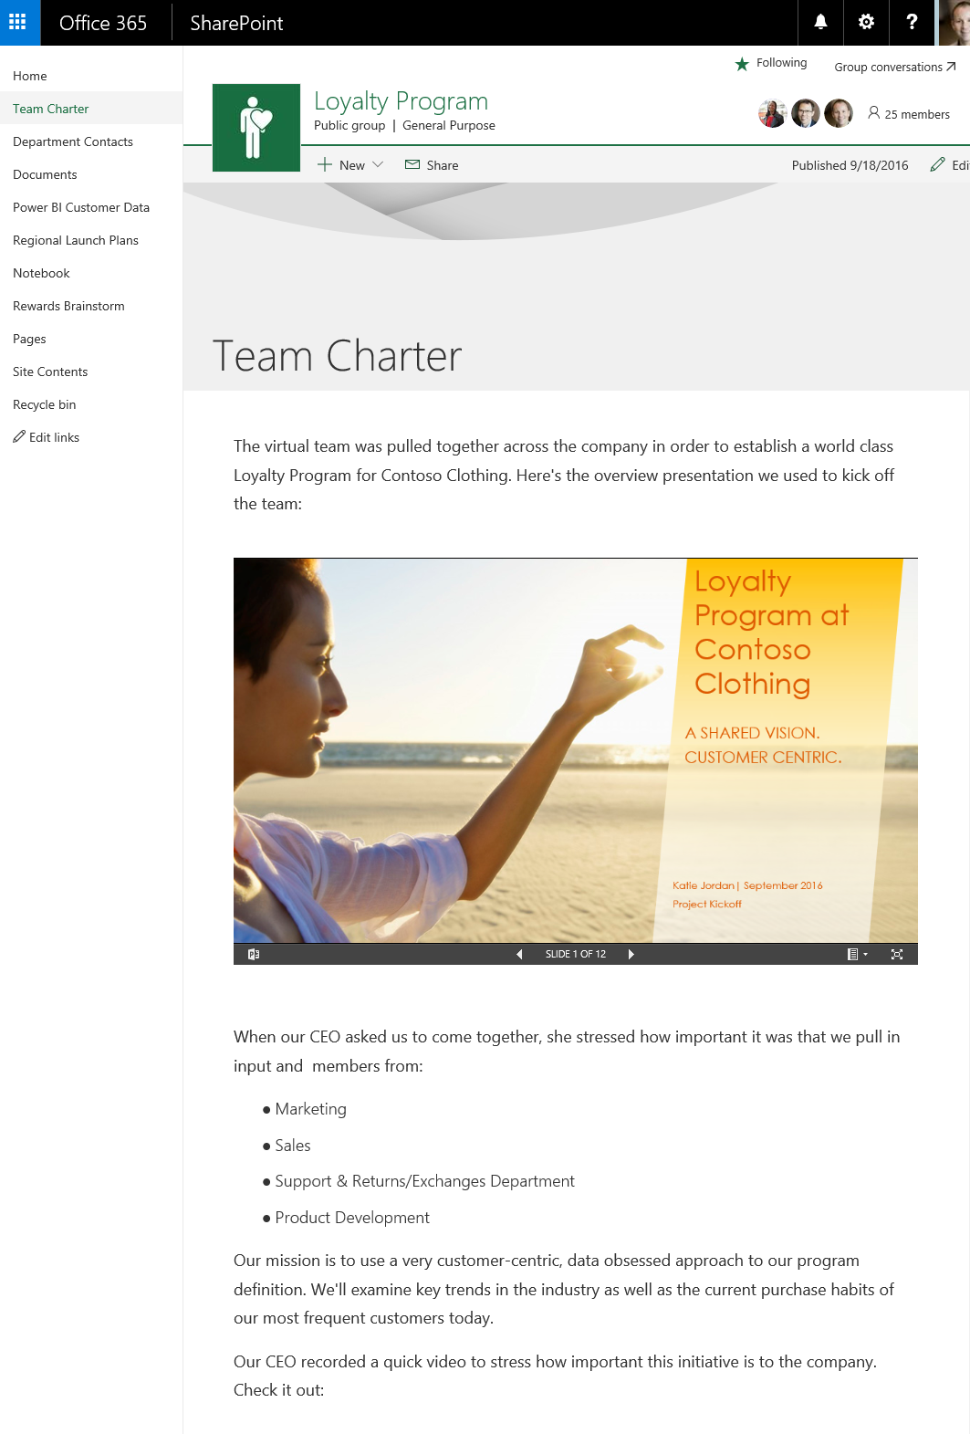
Modern Site Pages
Easily create powerful, beautiful looking pages
Communicate ideas and information using our new authoring canvas and gallery of web parts.
Modern building blocks
Authoring canvas and web parts are built using client-side HTML and JavaScript. Pages are reusable in custom applications
Mobile support is built in from the start
Content reflows across device sizes and pages are fast and fluid.
Pages get better with the Microsoft Graph
Authors can leverage Microsoft Graph to surface relevant pages to the people that need to read them.
Notes:
Open Source Office UI Fabric with responsive grid
Tight integration with native SharePoint apps
Shared middle tier microservices
Native chrome, chromeless mode
Native caching
Asset pre-fetching
Adjust information density based on viewport
SharePoint Home expanded to multiple tabs, content density reduced, not all crammed onto one page
Alternate layouts for webparts (e.g. WAC embeds change to card mode)
Image renditions
Exploring…
Incremental page load
HTTP/2
Native rendering, authoring

Slide 8
Modern pages: mobile, fast, and powerful
Mobile, both responsive and tight integration with SharePoint apps
Performance best practices baked in from Day 1, innovate over time
Powered by SPFx, Office Fabric, and shared middle tier microservices
Foundation for modern portals
Notes:
Open Source Office UI Fabric with responsive grid
Tight integration with native SharePoint apps
Shared middle tier microservices
Native chrome, chromeless mode
Native caching
Asset pre-fetching
Adjust information density based on viewport
SharePoint Home expanded to multiple tabs, content density reduced, not all crammed onto one page
Alternate layouts for webparts (e.g. WAC embeds change to card mode)
Image renditions
Exploring…
Incremental page load
HTTP/2
Native rendering, authoring

Slide 9
All JavaScript development? - No
In similar ways as with SharePoint Add-in model, server side development is needed for back end services
SharePoint Framework concentrates on user interface, not on fundamentals around the API usage

Slide 10
DEMO
Modern SharePoint pages and experience with out-of-the-box web parts
Notes:
The following exercises in the lab manual may be used for this demo:
Exercise 1: Create a hello world web part without any framework
Exercise 2: Create a hello world web part with the React framework
Exercise 3: Create a hello world web part in Angular 1.x
Exercise 4: Create a hello world web part in Knockout
Exercise 5: Create a hello world web part with jQuery

Slide 11
Summary
Overview
Demo
Extending
Q&A

Slide 12
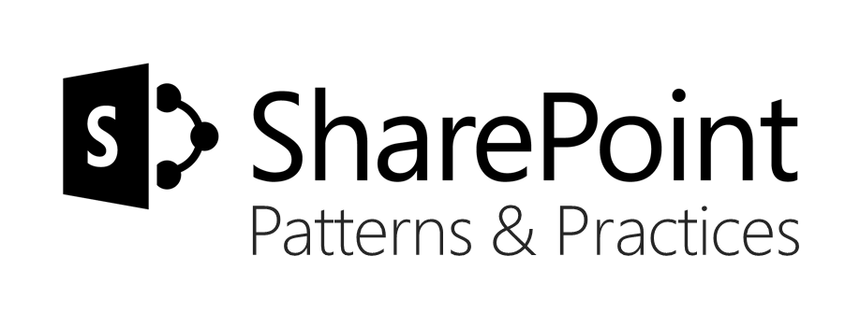
Sharing is caring…
Code samples and solutions
Reusable components
Guidance documentation
Monthly community calls
SharePoint Framework
SharePoint add-ins
Microsoft Graph
Office 365 APIs
http://aka.ms/SharePointPnP

Slide 13

Q&A

Slide 14


